Slide 1
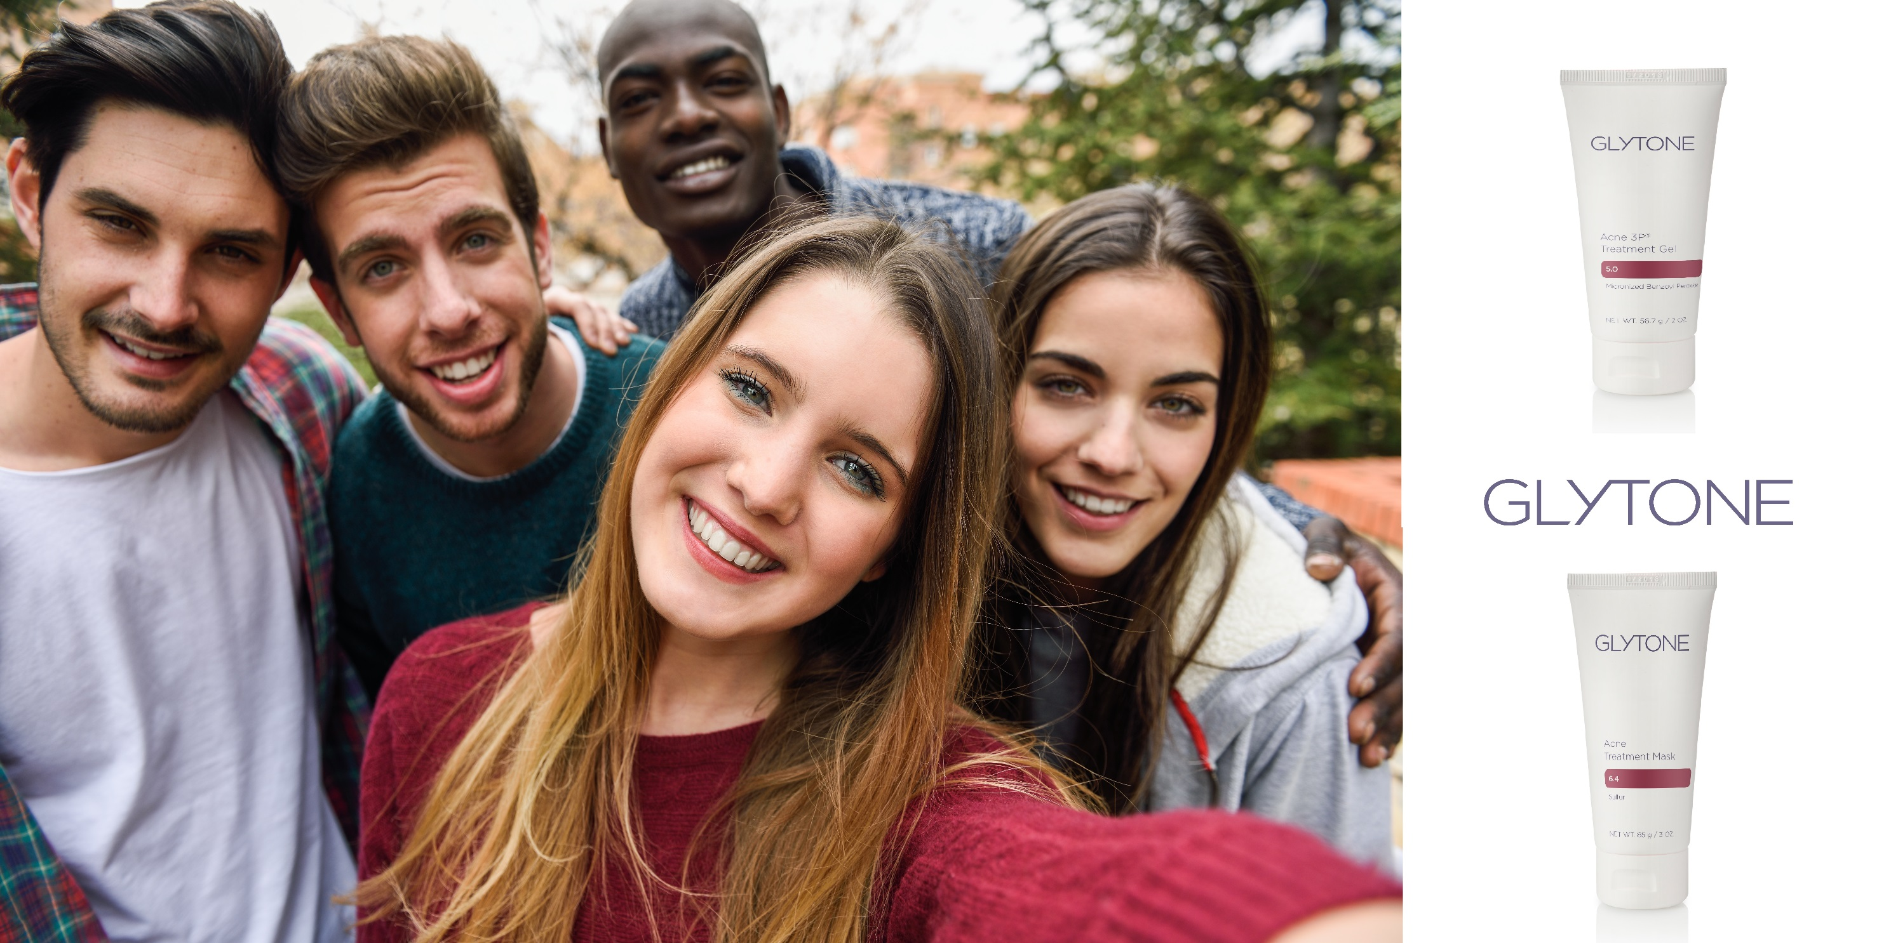
GET SELFIE-READY SKIN!
BUY ONE GLYTONE ACNE TREATMENT MASK AND GET
GLYTONE ACNE 3P GEL FOR ½ OFF!
AVAILABLE ONLINE AND AT SIGNATURE DERMATOLOGY

