Slide 1
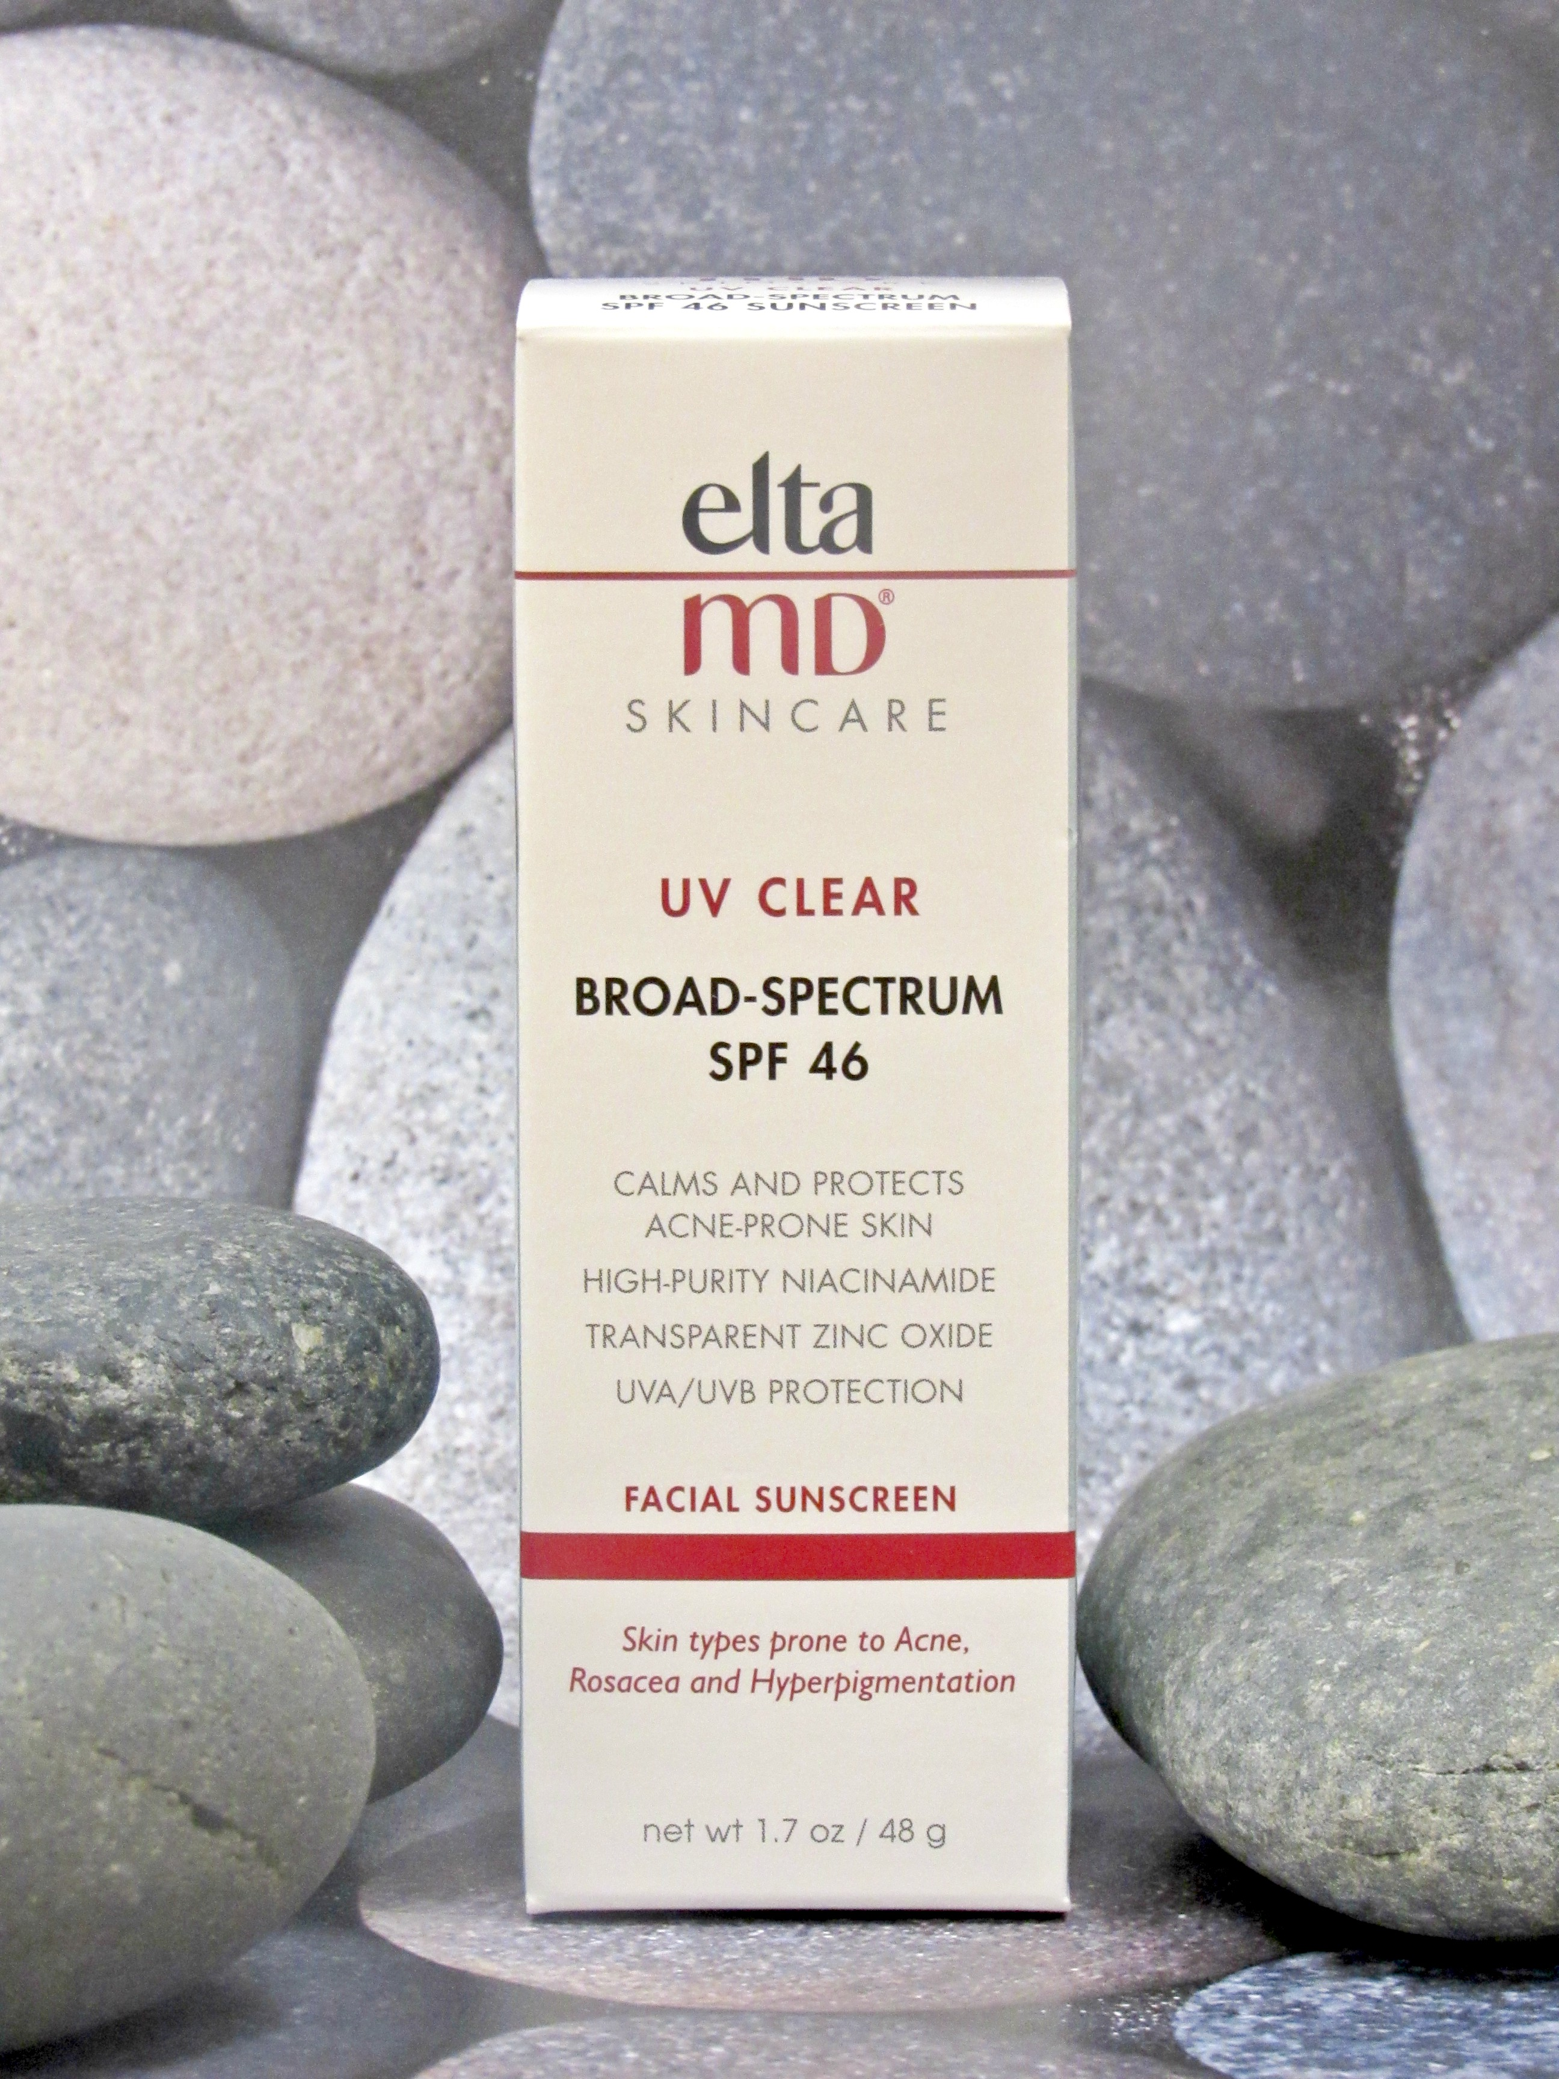
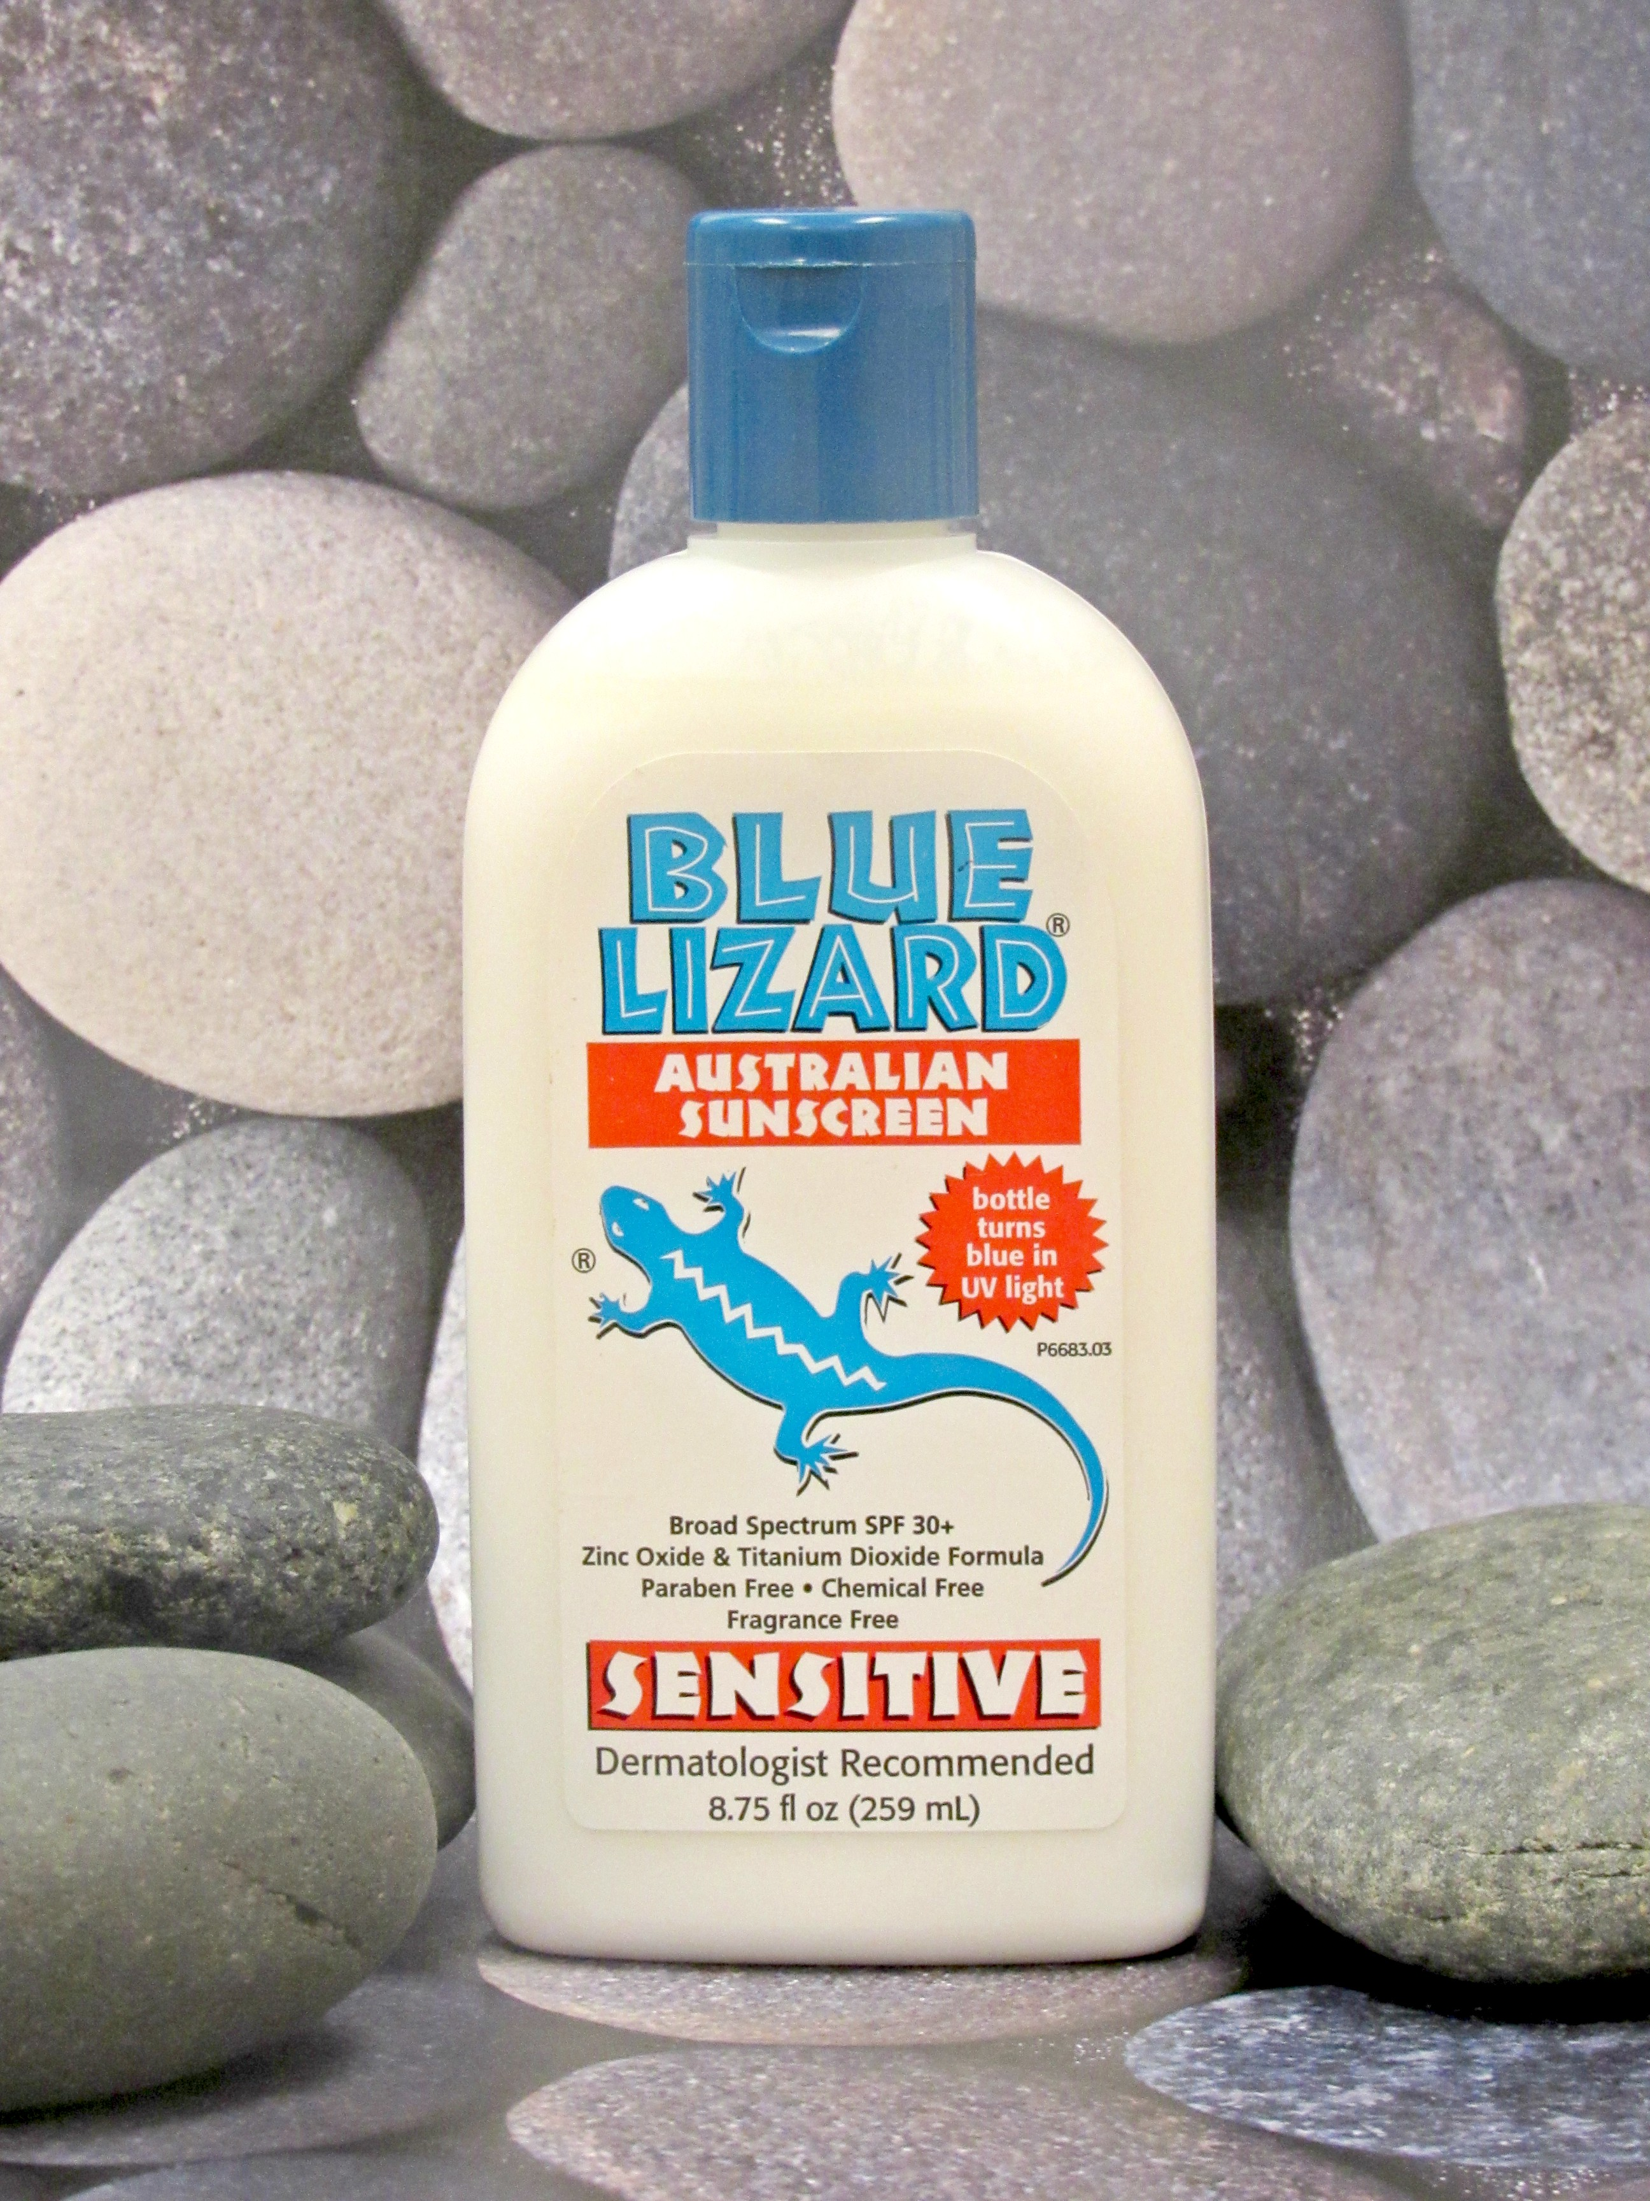
15% OFF ALL SUNSCREENS FOR THE ENTIRE MONTH OF MAY AVAILABLE ONLINE AND AT SIGNATURE DERMATOLOGY

